Slide 1
McElreath- Statistical Rethinking

Slide 2
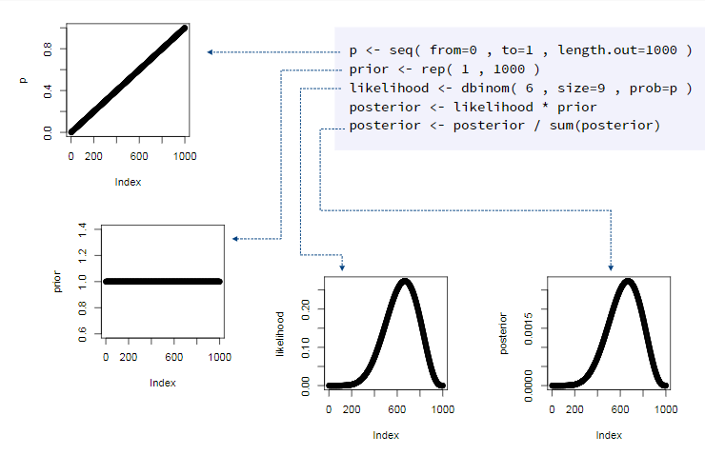
Script for grid approx.
P = parameter values

